Slide 1
Machine learning in every day life
What is machine learning:
Machine learning is integrated into everyday life through technologies like streaming service recommendations, personalized news feeds, and virtual assistants. Other examples include spam filters, fraud detection, facial recognition for unlocking phones, and traffic prediction services that optimize commute times. These algorithms learn from data to adapt and improve user experiences in various applications and industries.

Slide 2
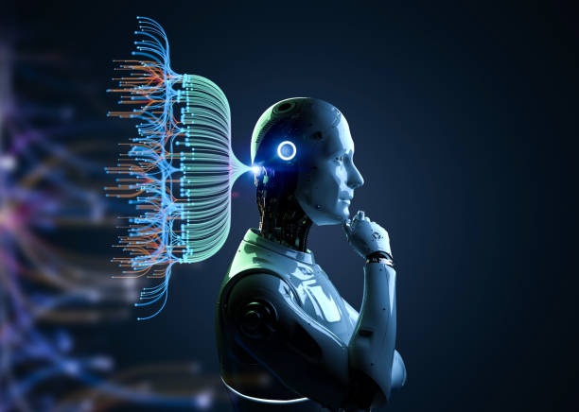
MACHINE LEARNING

Slide 3
Examples for machine learning in everyday life -
Facial Recognition:
Facial recognition is one of the more obvious applications of machine learning. People previously received name suggestions for their mobile photos and Facebook tagging, but now someone is immediately tagged and verified by comparing and analyzing patterns through facial contours. And facial recognition paired with deep learning has become highly useful in healthcare to help detect genetic diseases or track a patient’s use of medication more accurately. It’s also used to combat important social issues such as child sex trafficking or sexual exploitation of children. The list of applications and industries influenced by it is steadily on the rise.

Slide 4
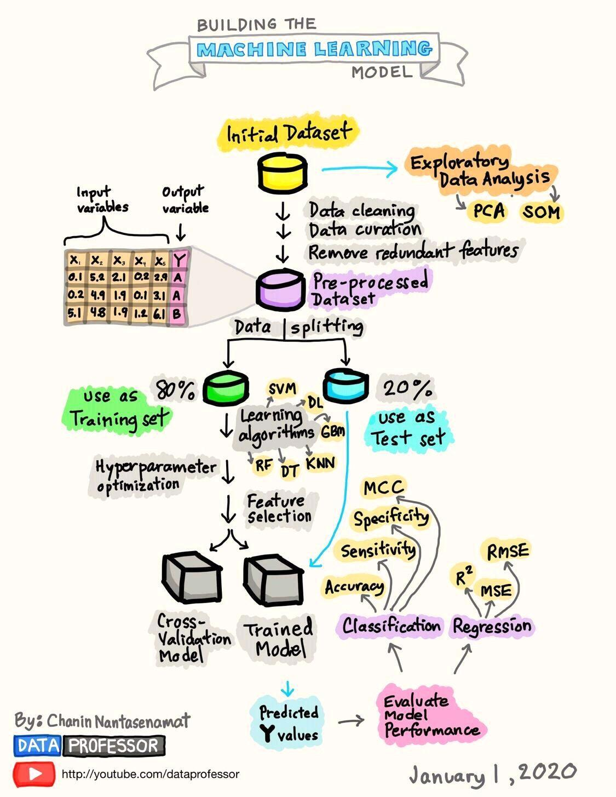

Slide 5
Product Recommendation:
Do you wonder how Amazon or other retailers frequently know what you might like to purchase? Or, have they gotten it wildly wrong and you wonder how they came up with the recommendation? Thank machine learning. Targeted marketing with retail uses machine learning to group customers based on buying habits or demographic similarities, and by extrapolating what one person may want from someone else’s purchases. While some suggested purchase pairings are obvious, machine learning can get eerily accurate by finding hidden relationships in data and predicting what you want before you know you want it. If the data is incomplete, sometimes you may end up with an offbase recommendation—but don’t worry, because not buying it is another data point to learn from.

Slide 6
Healthcare Advancement:
Every day, we’re getting closer to a full transition to electronic medical records. That means healthcare information for clinicians can be enhanced with analytics and machine learning to gain insights that support better planning and patient care, improved diagnoses, and lower treatment costs. Healthcare brands such as Pfizer and Providence have begun to benefit from analytics enhanced by human and artificial intelligence. There are some processes that are better suited to leverage machine learning; machine learning integration with radiology, cardiology, and pathology, for example, is leading to earlier detection of abnormalities or heightened attention on concerning areas. In the long run, machine learning will also benefit family practitioners or internists when treating patients bedside because data trends will predict health risks like heart disease. Example, wearables generate mass amounts of data on the wearer’s health and many use AI and machine learning to alert them or their doctors of issues to support preventative measures and respond to emergencies.

Slide 7
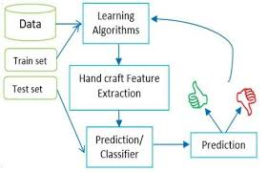
DIAGRAM FOR MACHINE LEARNING

Slide 8
Social Media Optimization:
Platforms from Facebook to Instagram and Twitter are using big data and artificial intelligence to enhance their functionality and strengthen the user experience. Machine learning has become helpful in fighting inappropriate content and cyberbullying, which pose a risk to platforms in losing users and weakening brand loyalty. Processing data through deep neural networks also allows social platforms to learn their users’ preferences as they offer content suggestions and target advertising.

Slide 9
How is machine learning used in everyday life:
Machine learning is applied in many real-life scenarios, such as powering recommendation engines (Netflix, YouTube), enabling virtual assistants (Siri, Alexa), and improving navigation apps by predicting traffic. Other common applications include spam filtering in email, fraud detection in finance, medical diagnosis assistance, image and speech recognition, and autonomous vehicles.

Slide 10
Types of machine learning:
Linear regression.
Polynomial regression.
K-nearest neighbors.
Naive Bayes.
Decision trees.

